Slide 1
Connecting to Open PHACTS API via Python/Pipeline Pilot
6th Open PHACTS Community Workshop
Register for the API at https://dev.openphacts.org/signup

Slide 2
Python
Online Python interpreter
http://www.compileonline.com/execute_python_online.php
Download Python
https://www.python.org/download/
For documentation, tutorials, beginners guides...
http://www.python.org

Slide 3
Python – Calling the API
Example
Building the URI
URI http://beta.openphacts.org/1.3/structure/substructure?app_id=your_app_id&app_key=your_app_key&searchOptions.Molecule=CC(%3DO)Oc1ccccc1C(%3DO)O+&searchOptions.MolType=0&resultOptions.Count=20&_format=tjson
URI anatomy
API plus version http://beta.openphacts.org/1.3
Call /structure/substructure
App ID & key ?app_id=your_app_id&app_key=your_app_key
Required parameters &searchOptions.Molecule=CC(%3DO)Oc1ccccc1C(%3DO)O+
Optional parameters &searchOptions.MolType=0&resultOptions.Count=20
Output format &_format=json (when left unspecified output defaults to json)

Slide 4
Python – Calling the API
Example
import urllib2
import urllib
smiles = 'CC(=O)Oc1ccccc1C(=O)O‘
enc_smiles = urllib.quote_plus(smiles)
api_response = urllib2.urlopen("http://beta.openphacts.org/1.3/structure/substructure?app_id=your_app_id&app_key=your_app_key&searchOptions.Molecule=%s&resultOptions.Count=1&_format=json" % enc_smiles).read()
print api_response

Slide 5
Python – Handling the Output
Available formats:
json (JavaScript Object Notation)
tsv (Tab-separated values)
ttl (Terse RDF Triple Language)
xml (Extensible Markup Language)
rdf (Resource Description Framework)
rdfjson
Html (HypetText Markup Language)

Slide 6
Python – Handling the Output
json (JavaScript Object Notation) default output e.g.
{
"format": "linked-data-api",
"version": "1.3", "result":
{ "_about": "https://beta.openphacts.org/1.3/structure/substructure?app_id=your_app_id&
app_key=your_app_key&searchOptions.Molecule=CC(%3DO)Oc1ccccc1C(%3DO)O
&resultOptions.Count=1",
"definition": "https://beta.openphacts.org/api-config",
"extendedMetadataVersion": "https://beta.openphacts.org/1.3/structure/substructure?app_id=your_app_id&
app_key=your_app_key&searchOptions.Molecule=CC(%3DO)Oc1ccccc1C(%3DO)O
&resultOptions.Count=1&_metadata=all%2Cviews%2Cformats%2Cexecution%2Cbindings%2Csite",
"primaryTopic": {
"_about": "http://www.openphacts.org/api/ChemicalStructureSearch",
"result": {
"_about": "http://ops.rsc.org/OPS403534",
"relevance": 1
},
"Count": "1",
"Molecule": "CC(=O)Oc1ccccc1C(=O)O",
"type": "http://www.openphacts.org/api/SubstructureSearch",
"isPrimaryTopicOf": "https://beta.openphacts.org/1.3/structure/substructure?app_id=your_app_id&
app_key=your_app_key&searchOptions.Molecule=CC(%3DO)Oc1ccccc1C(%3DO)O&resultOptions.Count=1"
}
}
}

Slide 7
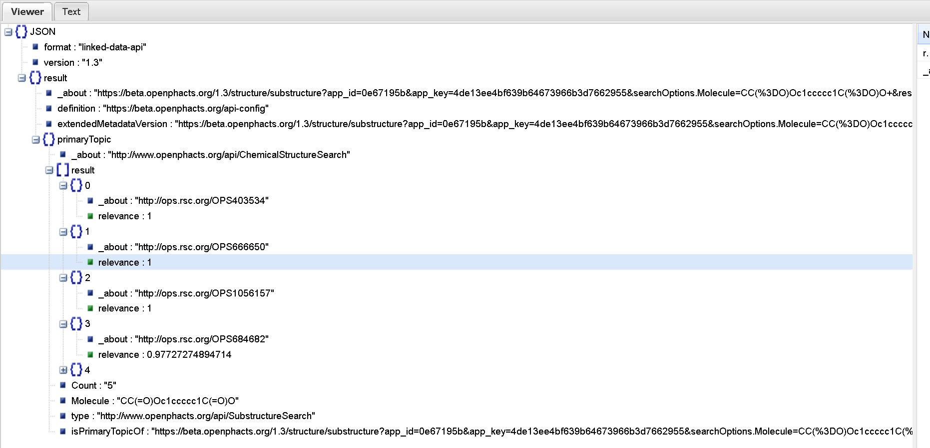
Python – Handling the Output
Online json viewer
http://jsonviewer.stack.hu/

Slide 8
Python – Handling the Output
Python treats json output as a string –
import json
json_obj = json.loads(api_response)
result_list = json_obj['result']['primaryTopic']['result']
for data in result_list:
print data
json output can be treated as a multidimensional Python dictionary
{u'relevance': 1, u'_about': u'http://ops.rsc.org/OPS403534'}
{u'relevance': 1, u'_about': u'http://ops.rsc.org/OPS666650'}
{u'relevance': 1, u'_about': u'http://ops.rsc.org/OPS1056157'}
{u'relevance': 0.97727274894714, u'_about': u'http://ops.rsc.org/OPS684682'}
{u'relevance': 0.97727274894714, u'_about': u'http://ops.rsc.org/OPS1522274'}

Slide 9
Python – Full code for example
import urllib2
import urllib
import json
smiles = 'CC(=O)Oc1ccccc1C(=O)O‚
enc_smiles = urllib.quote_plus(smiles)
api_response = urllib2.urlopen("http://beta.openphacts.org/1.3/structure/substructure?app_id=0e67195b&app_key=4de13ee4bf639b64673966b3d7662955&searchOptions.Molecule=%s&resultOptions.Count=5&_format=json" % enc_smiles).read()
print api_response
json_obj = json.loads(api_response)
result_list = json_obj['result']['primaryTopic']['result']
for data in result_list:
print data

Slide 10
Pipeline Pilot (Accelrys‘ scientific informatics platform)
Pipeline Pilot
http://accelrys.com/products/pipeline-pilot/
Accelrys Academic Solutions
http://accelrys.com/micro/academic/
Open PHACTS Component Collection 2.0
https://community.accelrys.com/docs/DOC-6547
Open PHACTS Pipeline Pilot Community Portal
https://community.accelrys.com/groups/openphacts

Slide 11
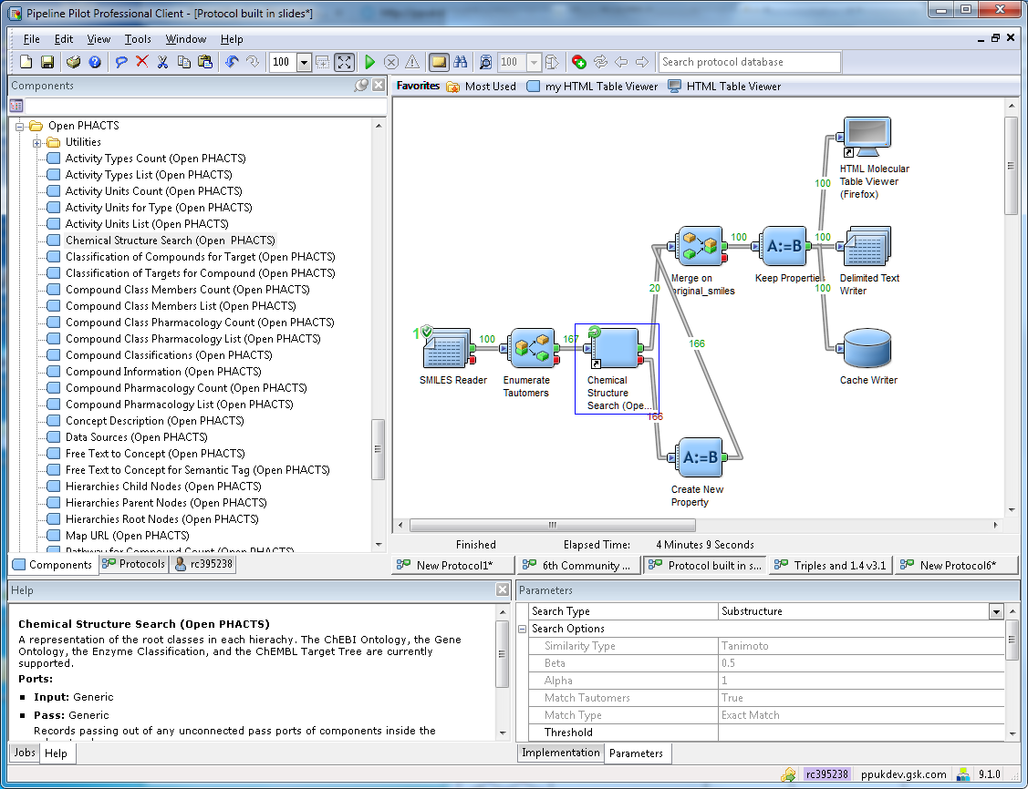
Pipeline Pilot
Open PHACTS components
Open PHACTS chemical structure search component
Component Parameters
Description of selected component

Slide 12
Pipeline Pilot
Building a protocol
Feeding in data
Preparing data for the API component
API component
Handling the output
Saving the results

Slide 13
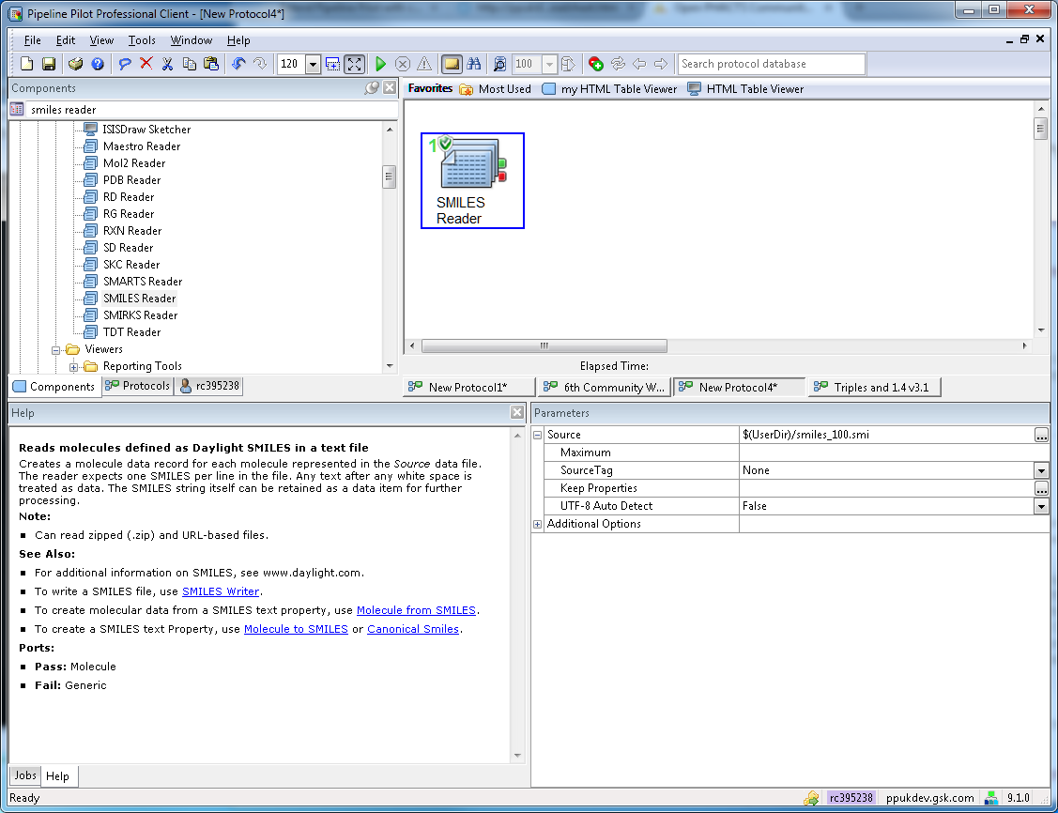
Pipeline Pilot – 1. Feeding in data
What format is the Input?

Slide 14
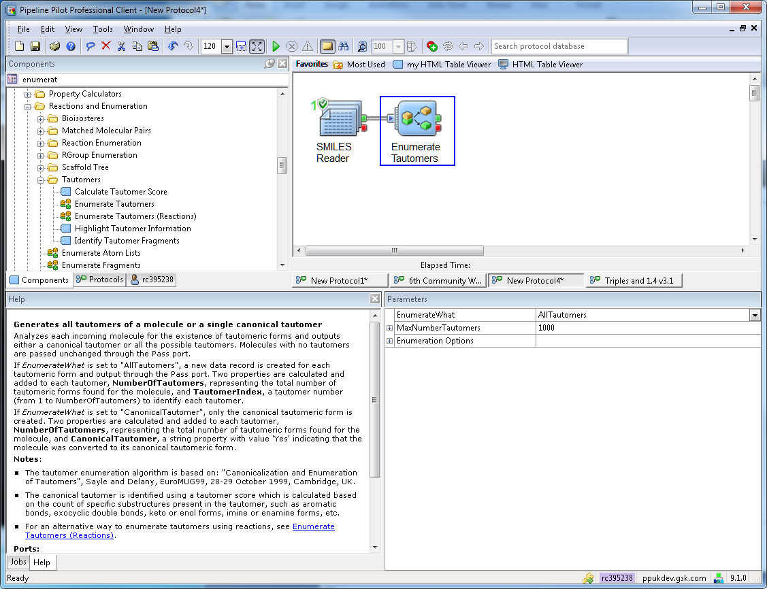
Pipeline Pilot – 2. Preparing data for the API component
Does the input data need altered?
Is the input data complete? E.g. do tautomers need to baccounted for?

Slide 15
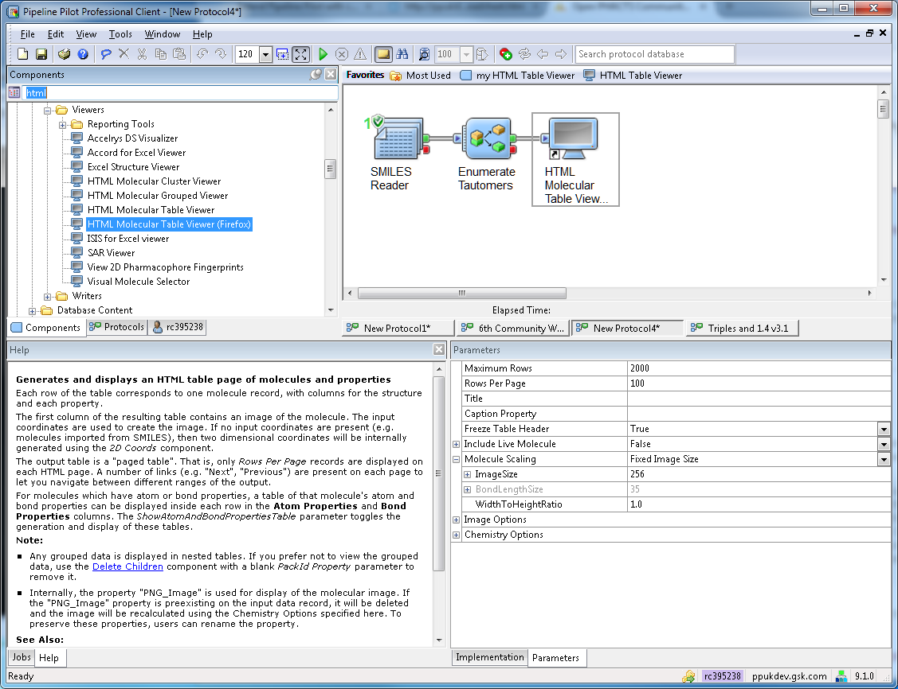
Pipeline Pilot – Keeping track of data
HTML Molecular
Table Viewer

Slide 16
Pipeline Pilot – Keeping track of data
HTML Molecular
Table Viewer

Slide 17
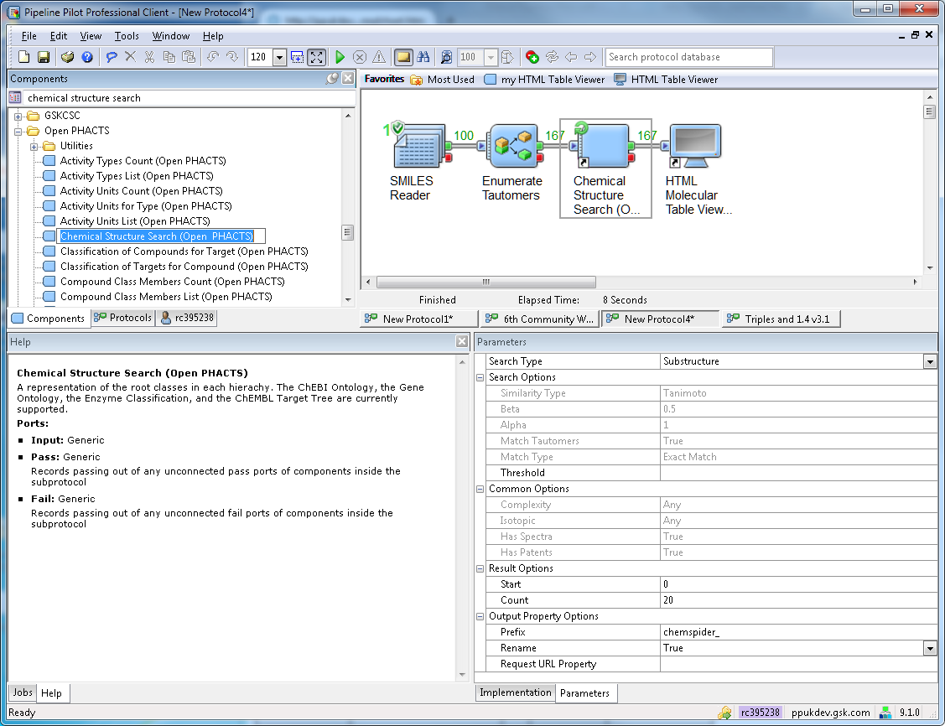
Pipeline Pilot – 3. API component
Same parameters as available on the API dev page

Slide 18
Pipeline Pilot – 4. Handling the Output

Slide 19
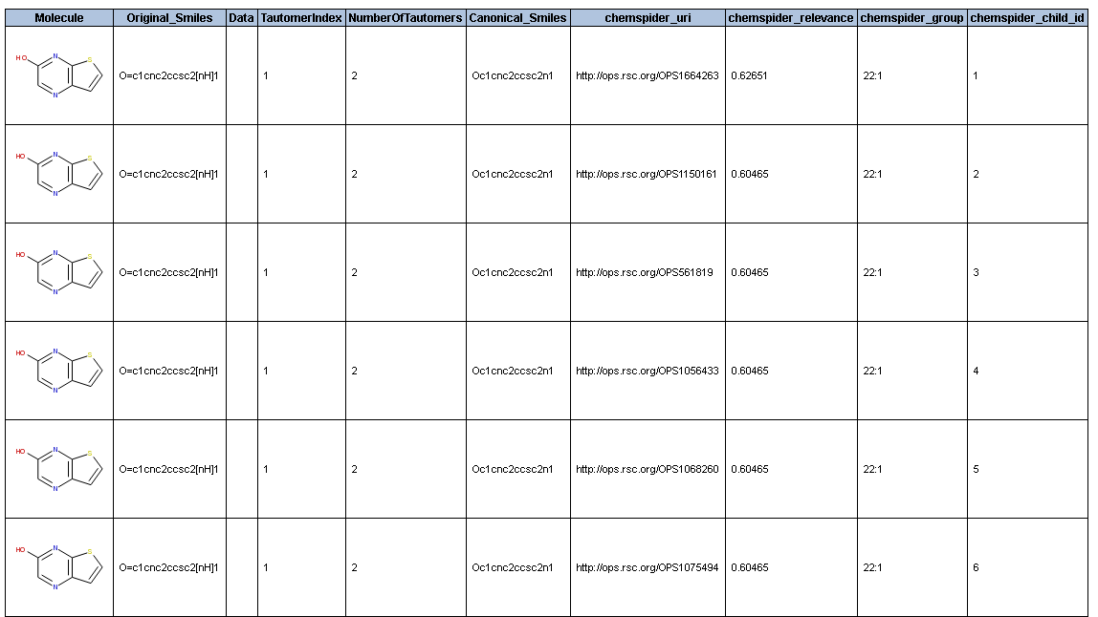
Pipeline Pilot – 4. Handling the Output

Slide 20
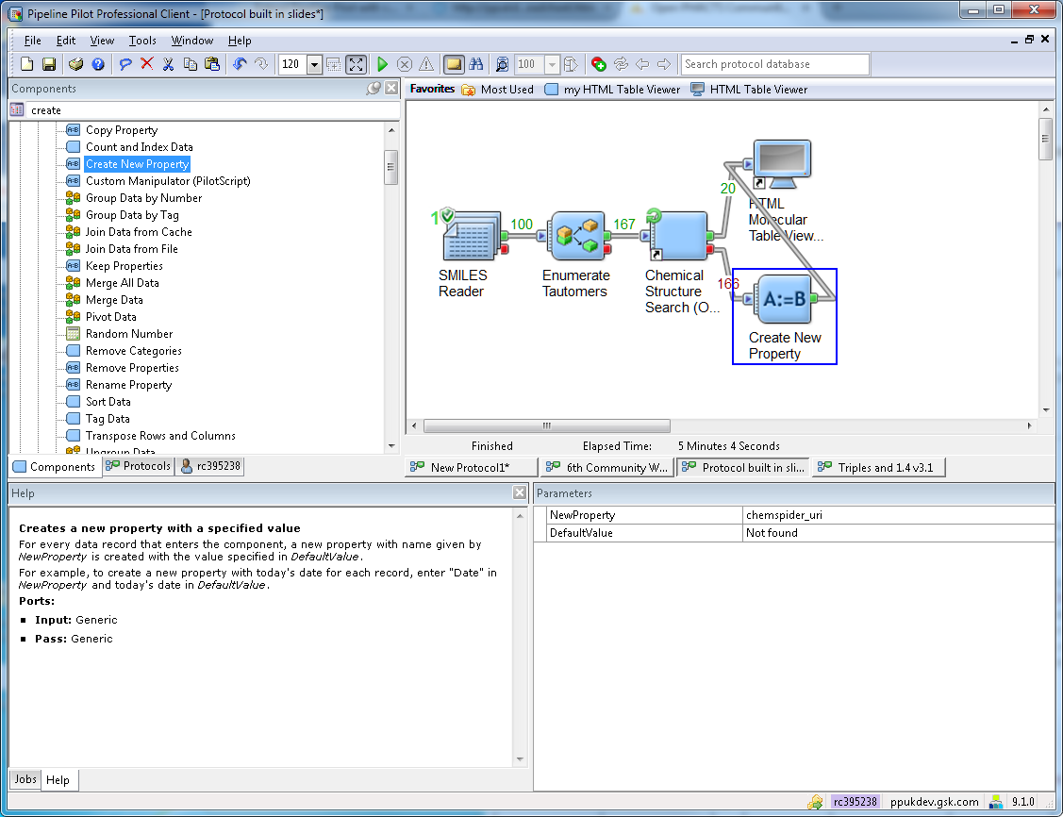
Pipeline Pilot – 4. Handling the Output

Slide 21
Pipeline Pilot – 4. Handling the Output

Slide 22
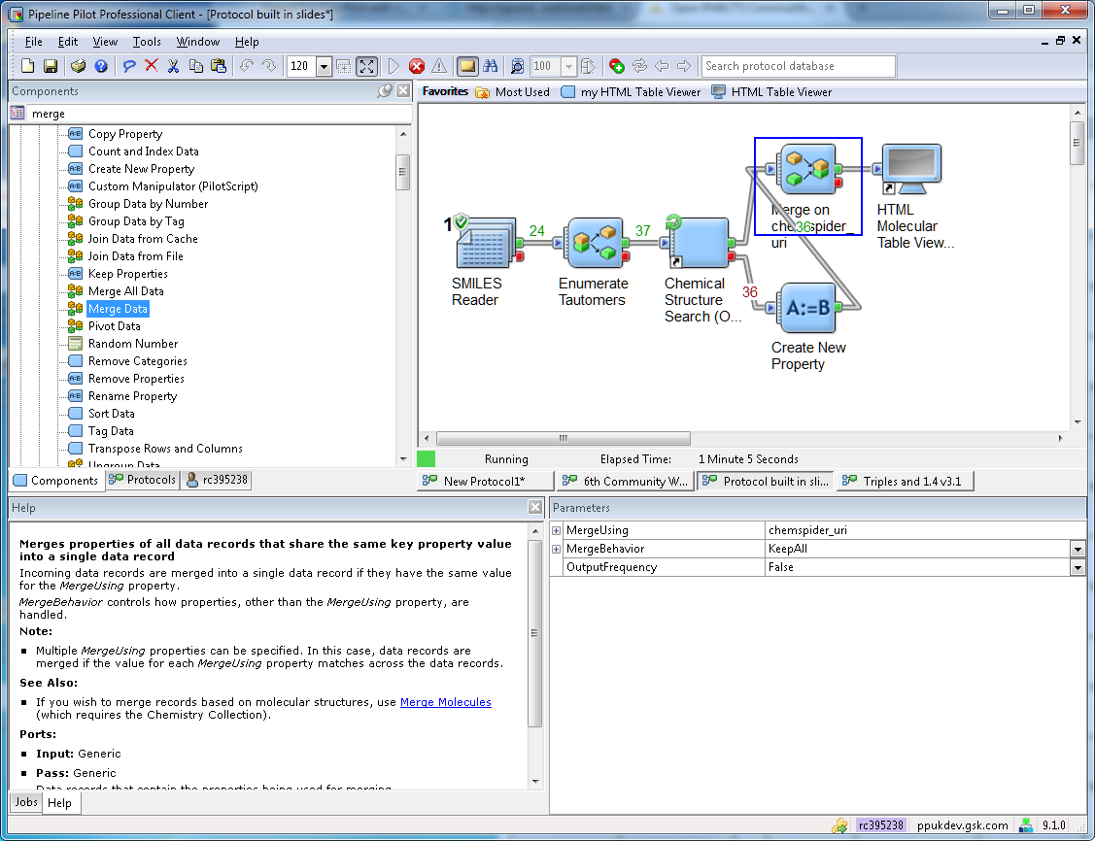
Pipeline Pilot – 4. Handling the Output

Slide 23
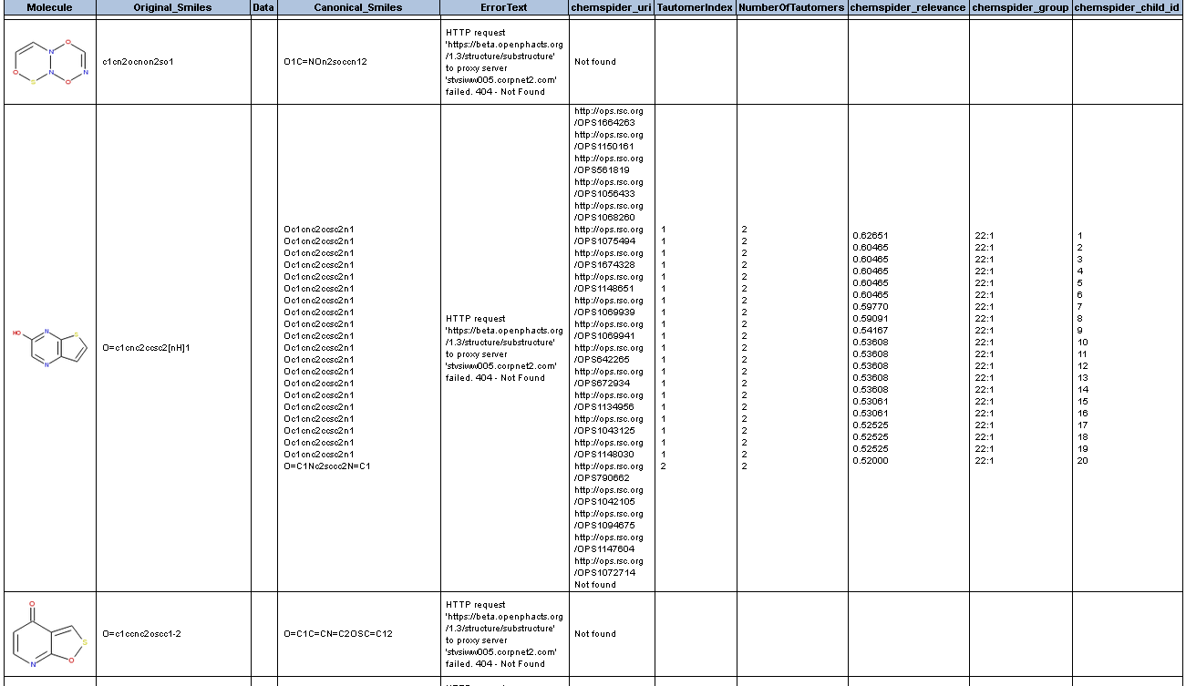
Pipeline Pilot – 4. Handling the Output

Slide 24
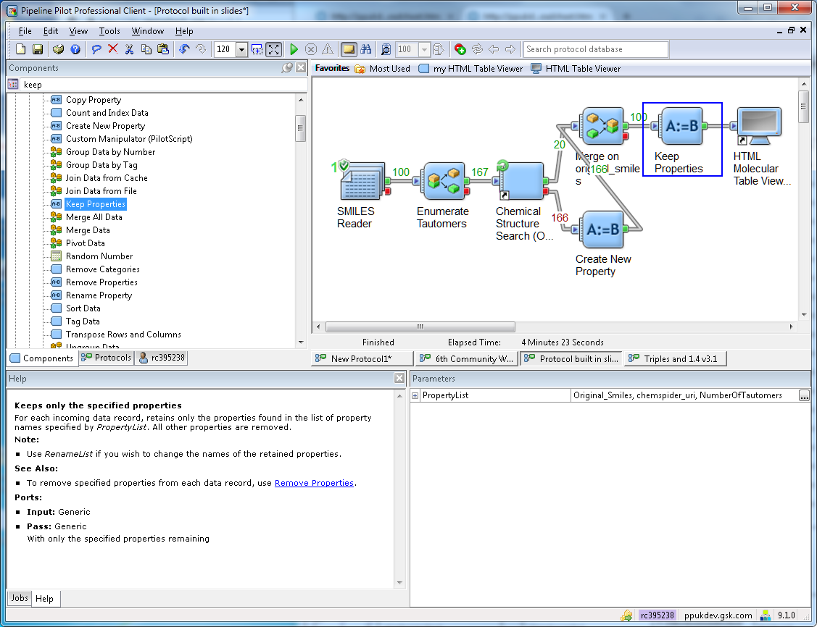
Pipeline Pilot – 4. Handling the Output

Slide 25
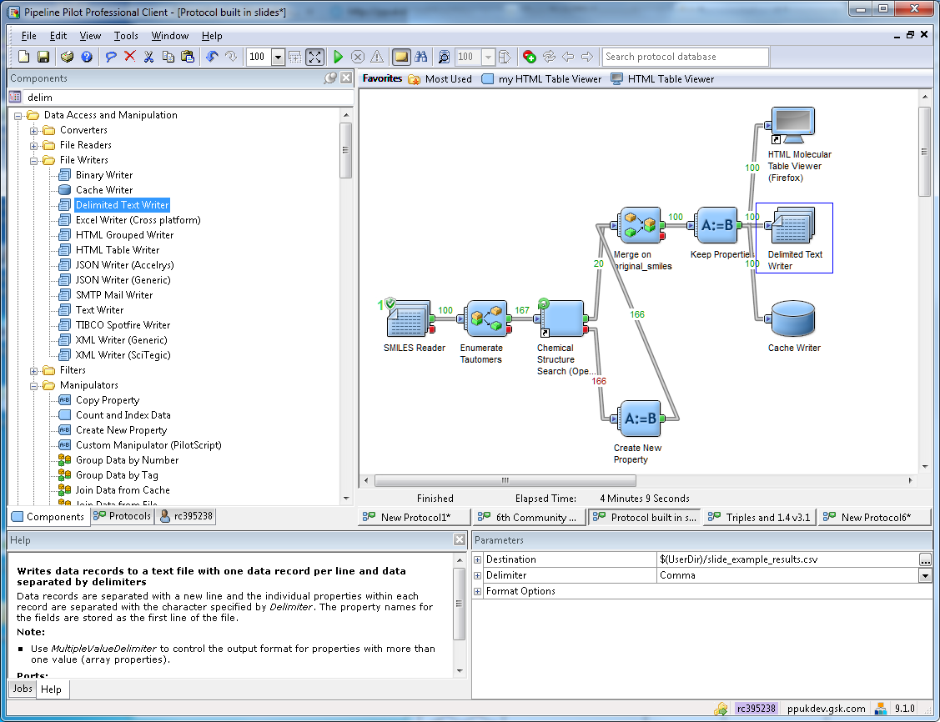
Pipeline Pilot – 5. Saving the results

